Slide 1
Data Structures and Algorithms -3 (25CS2103E)
Plagiarism Detection Engine for Academic Submissions
Team No. 01
2520080015 : Veridhi Hari Priya
2520080058 : G. Anirudh
2520080068 : M. Sai Harika
Under the Esteemed Guidance of
Dr. Dyuti Banerjee
AI & DS

Slide 2
Contents
Abstract
Introduction
Literature survey
Problem Statement and Objectives
Hardware and Software requirements
Results
Conclusion
Future Scope

Slide 3
Abstract
The Plagiarism Detection Engine for Academic Submissions is a DSA-based project designed to identify similar or duplicated content in academic documents. It uses data structures such as Lists, HashMaps, Stacks, and Queues to efficiently store and manage document data. Searching, sorting, and string comparison algorithms are used to detect matching words or phrases and calculate a similarity percentage. The system helps reduce manual effort and demonstrates the practical application of Data Structures and Algorithms in solving a real-world academic problem.

Slide 4
Introduction
Plagiarism is a major issue in academic submissions.
Checking many assignments manually is difficult and time-consuming.
A DSA-based system can efficiently store, organize, search, and compare document content.
Arrays/Lists can store submissions and words.
HashMaps can store word frequencies for efficient comparison.
Searching algorithms help find specific words or phrases.
Sorting algorithms can organize similarity results.
The system identifies similar content and calculates a similarity percentage.

Slide 5
Literature Survey
Traditional plagiarism detection methods use manual checking and direct text comparison.
Basic systems compare documents using string matching techniques.
Data structures such as Arrays, Hash Tables, and Lists improve the storage and retrieval of document data.
Hashing can efficiently identify common words between documents.
Searching and sorting algorithms help process and organize comparison results.
Advanced plagiarism systems may use NLP and AI, but this project focuses on implementing the core concept using DSA techniques.

Slide 6
Problem Statement and Objectives
Academic institutions receive a large number of student assignments and submissions. Manually comparing every document is time-consuming and inefficient. A system is required to efficiently store submissions, compare their content, identify duplicate or common words, and display similarity results.
The problem is to design a DSA-based plagiarism detection engine using appropriate data structures and algorithms for efficient document storage, searching, comparison, and sorting of results.
To develop a plagiarism detection system based on Data Structures and Algorithms.
To store academic submissions efficiently using Arrays or Lists.
To use HashMaps/Hash Tables for word-frequency storage.
To use Searching algorithms for finding words or phrases.
To compare submissions and identify common content.
To calculate the similarity percentage between documents.
To use Sorting algorithms to arrange results based on similarity.
To demonstrate real-world applications of DSA concepts.

Slide 7
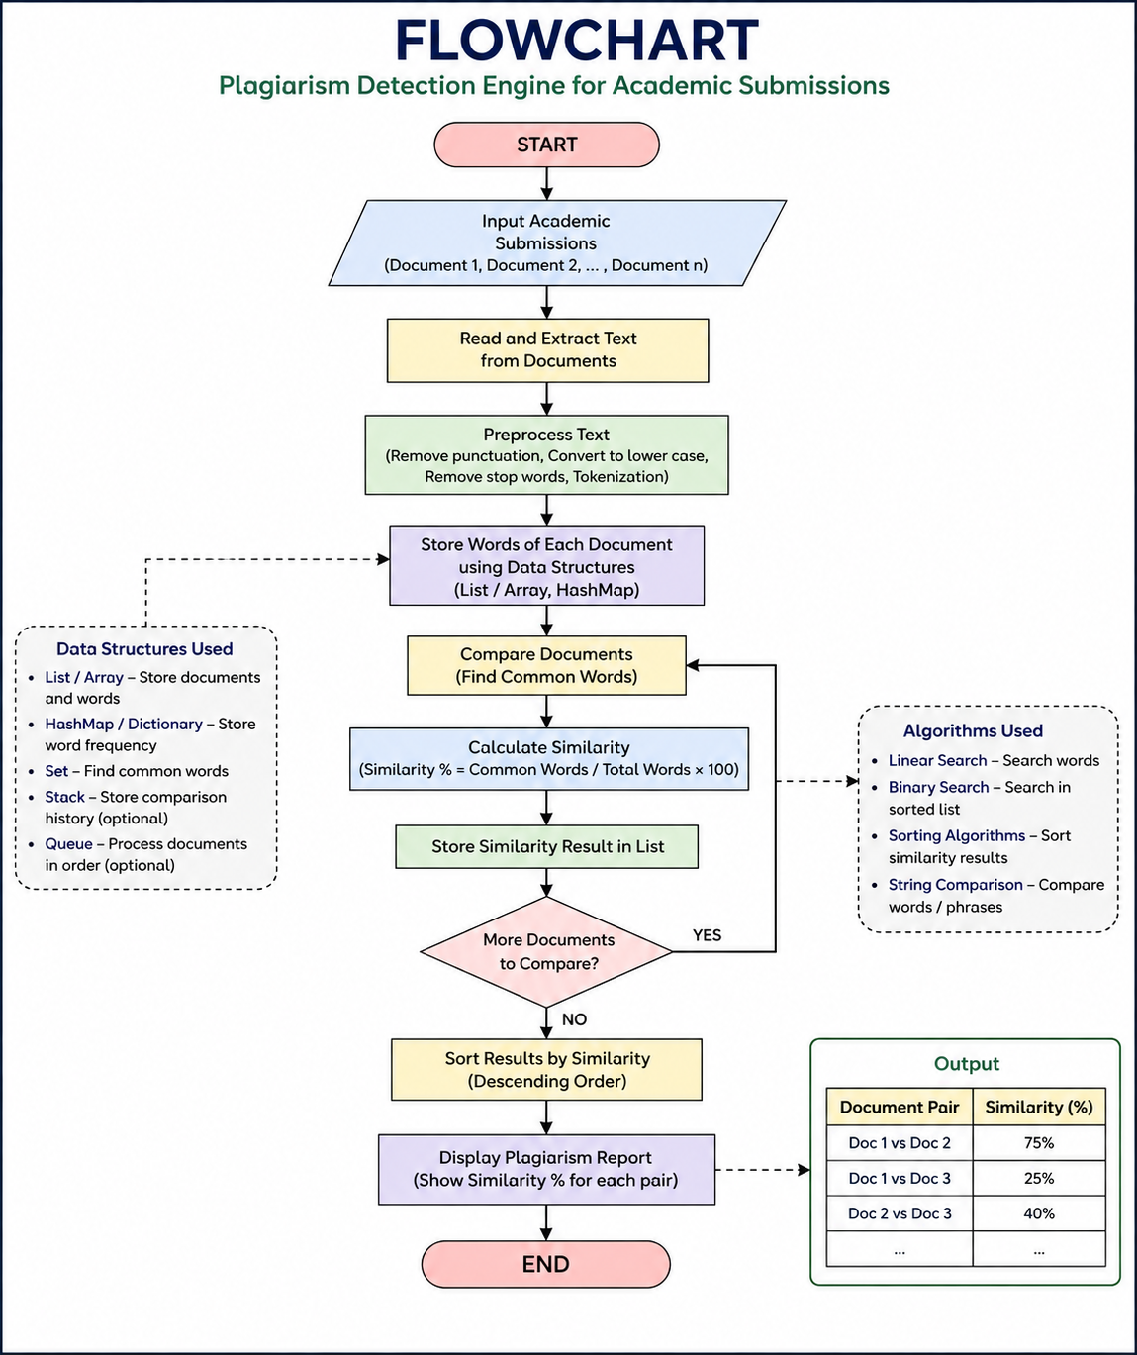
Flow Chart

Slide 8
Results
The system successfully stores and processes multiple academic submissions.
It identifies common words between documents.
Hash-based data structures provide efficient word lookup.
Searching algorithms help retrieve required content.
Sorting algorithms arrange documents according to similarity.
The system calculates and displays the plagiarism similarity percentage.

Slide 9
Hardware and Software requirements
Hardware
Processor: Intel Core i5 or above
RAM: Minimum 4 GB
Storage: Minimum 500 MB free space
System: Laptop or Desktop
Software
Programming Language: Python 3.x
IDE: VS Code
Operating System: Windows, Linux, or macOS
Libraries: Python built-in data structures and modules

Slide 10
Conclusion
The Plagiarism Detection Engine for Academic Submissions demonstrates how Data Structures and Algorithms can be applied to solve a real-world problem. The project uses data structures such as Lists, HashMaps, Stacks, and Queues for storing and managing data, while searching, sorting, and comparison algorithms are used to detect similar content. The system provides an efficient way to compare academic submissions and identify potential plagiarism.

Slide 11
Future Scope
Compare a larger number of documents efficiently.
Implement advanced string-matching algorithms such as KMP or Rabin-Karp.
Improve phrase and sentence-level comparison.
Add Trie data structures for faster word searching.
Use more efficient sorting algorithms for large datasets.
Develop a graphical or web-based interface.
Support PDF and DOCX academic submissions.
Add database storage for plagiarism history.

Slide 12
Thank you

